Slide 1




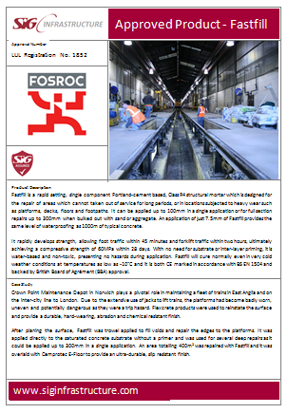



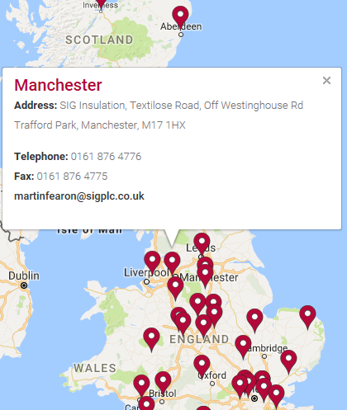





Track side
Rail Approved Products
Groundworks
Station
Electrification
BUY
NOW

